Slide 1
How do we perceive our digital world?

Slide 2
Erasmus + ka229 project 1. 9. 2019 – 31. 8. 2022
We are glad to present to you our Erasmus + KA229 project titled How do we perceive our cyber world? The participants in this project were: Philological High School from Serbia (Belgrade), Spanish high school Ordoño II (Segundo) from León and as coordinator school I. gimnazija v Celju from Slovenia.

Slide 3
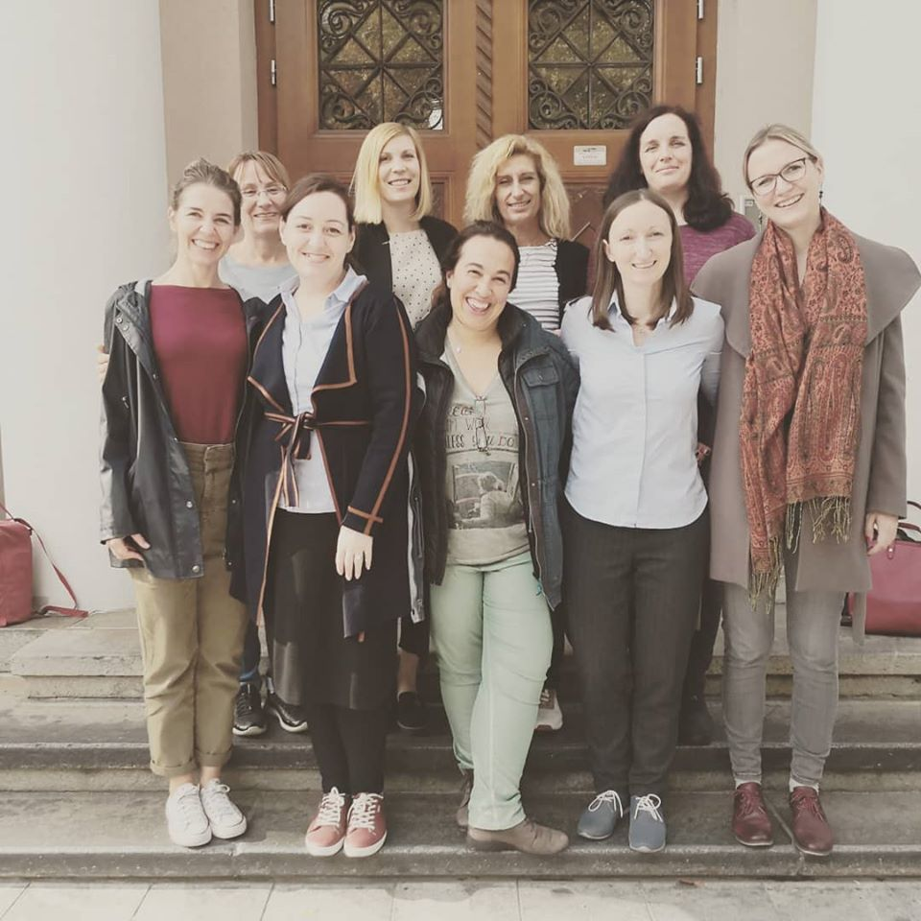
Teacher training in celje 16. – 18. 10. 2019
Teacher training in Celje where our teachers were equipped with new knowledge regarding fake news, media stereotypes etc.

Slide 4
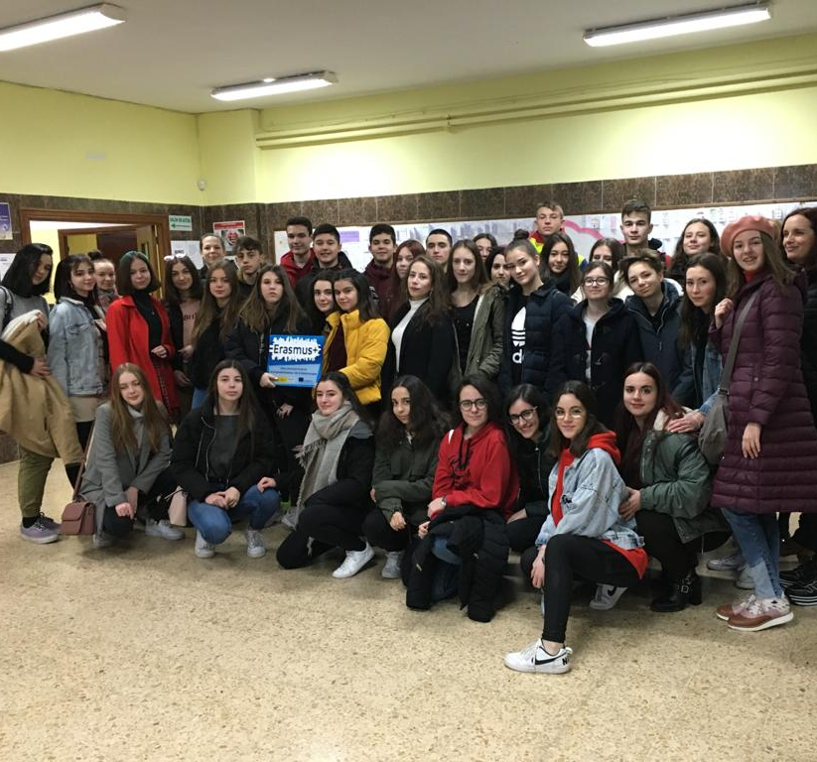
Short-term student exchange in león, spain, 2. – 8. 2. 2020
The short-term student mobility in León where we learnt about fake news, credible news and internet safety. We also visited INCIBE (National Institute for Cyber Security).

Slide 5
VideoconferenceS

Slide 6
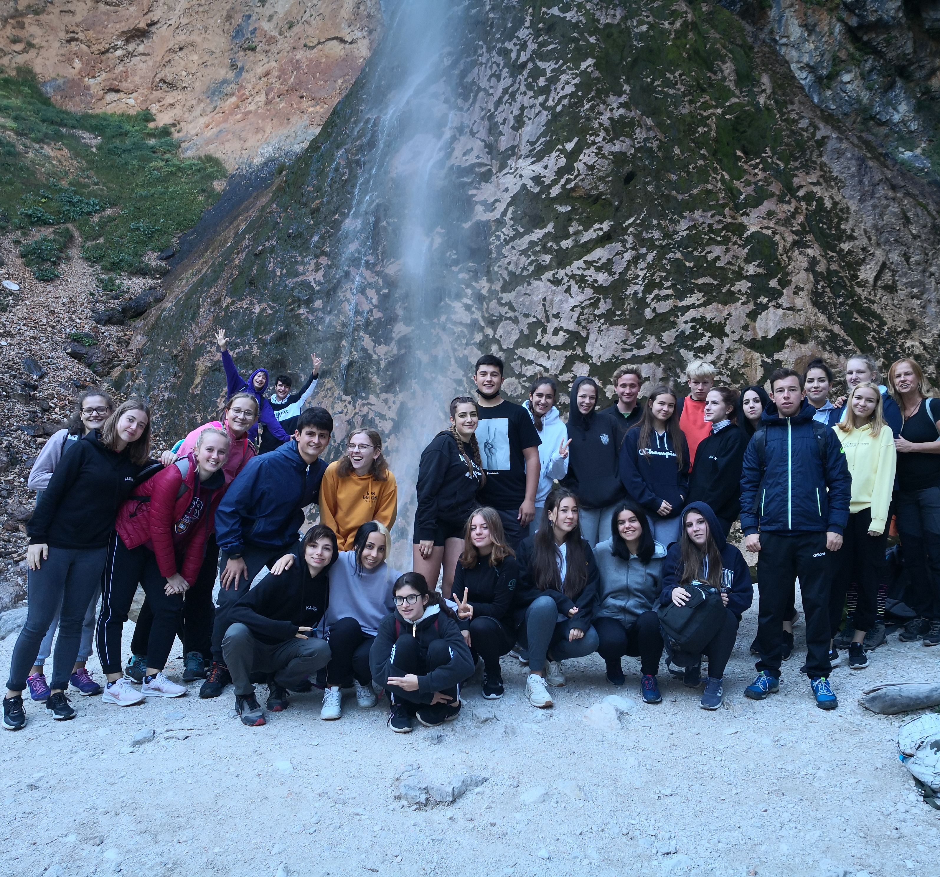
Short-term student exchange in celje, 20. – 24. 9. 2021
The short-term student mobility in Celje where we learnt about ourselves, our identity, how it changes when we are online and what we can do to prevent addiction and generate more well-being.

Slide 7
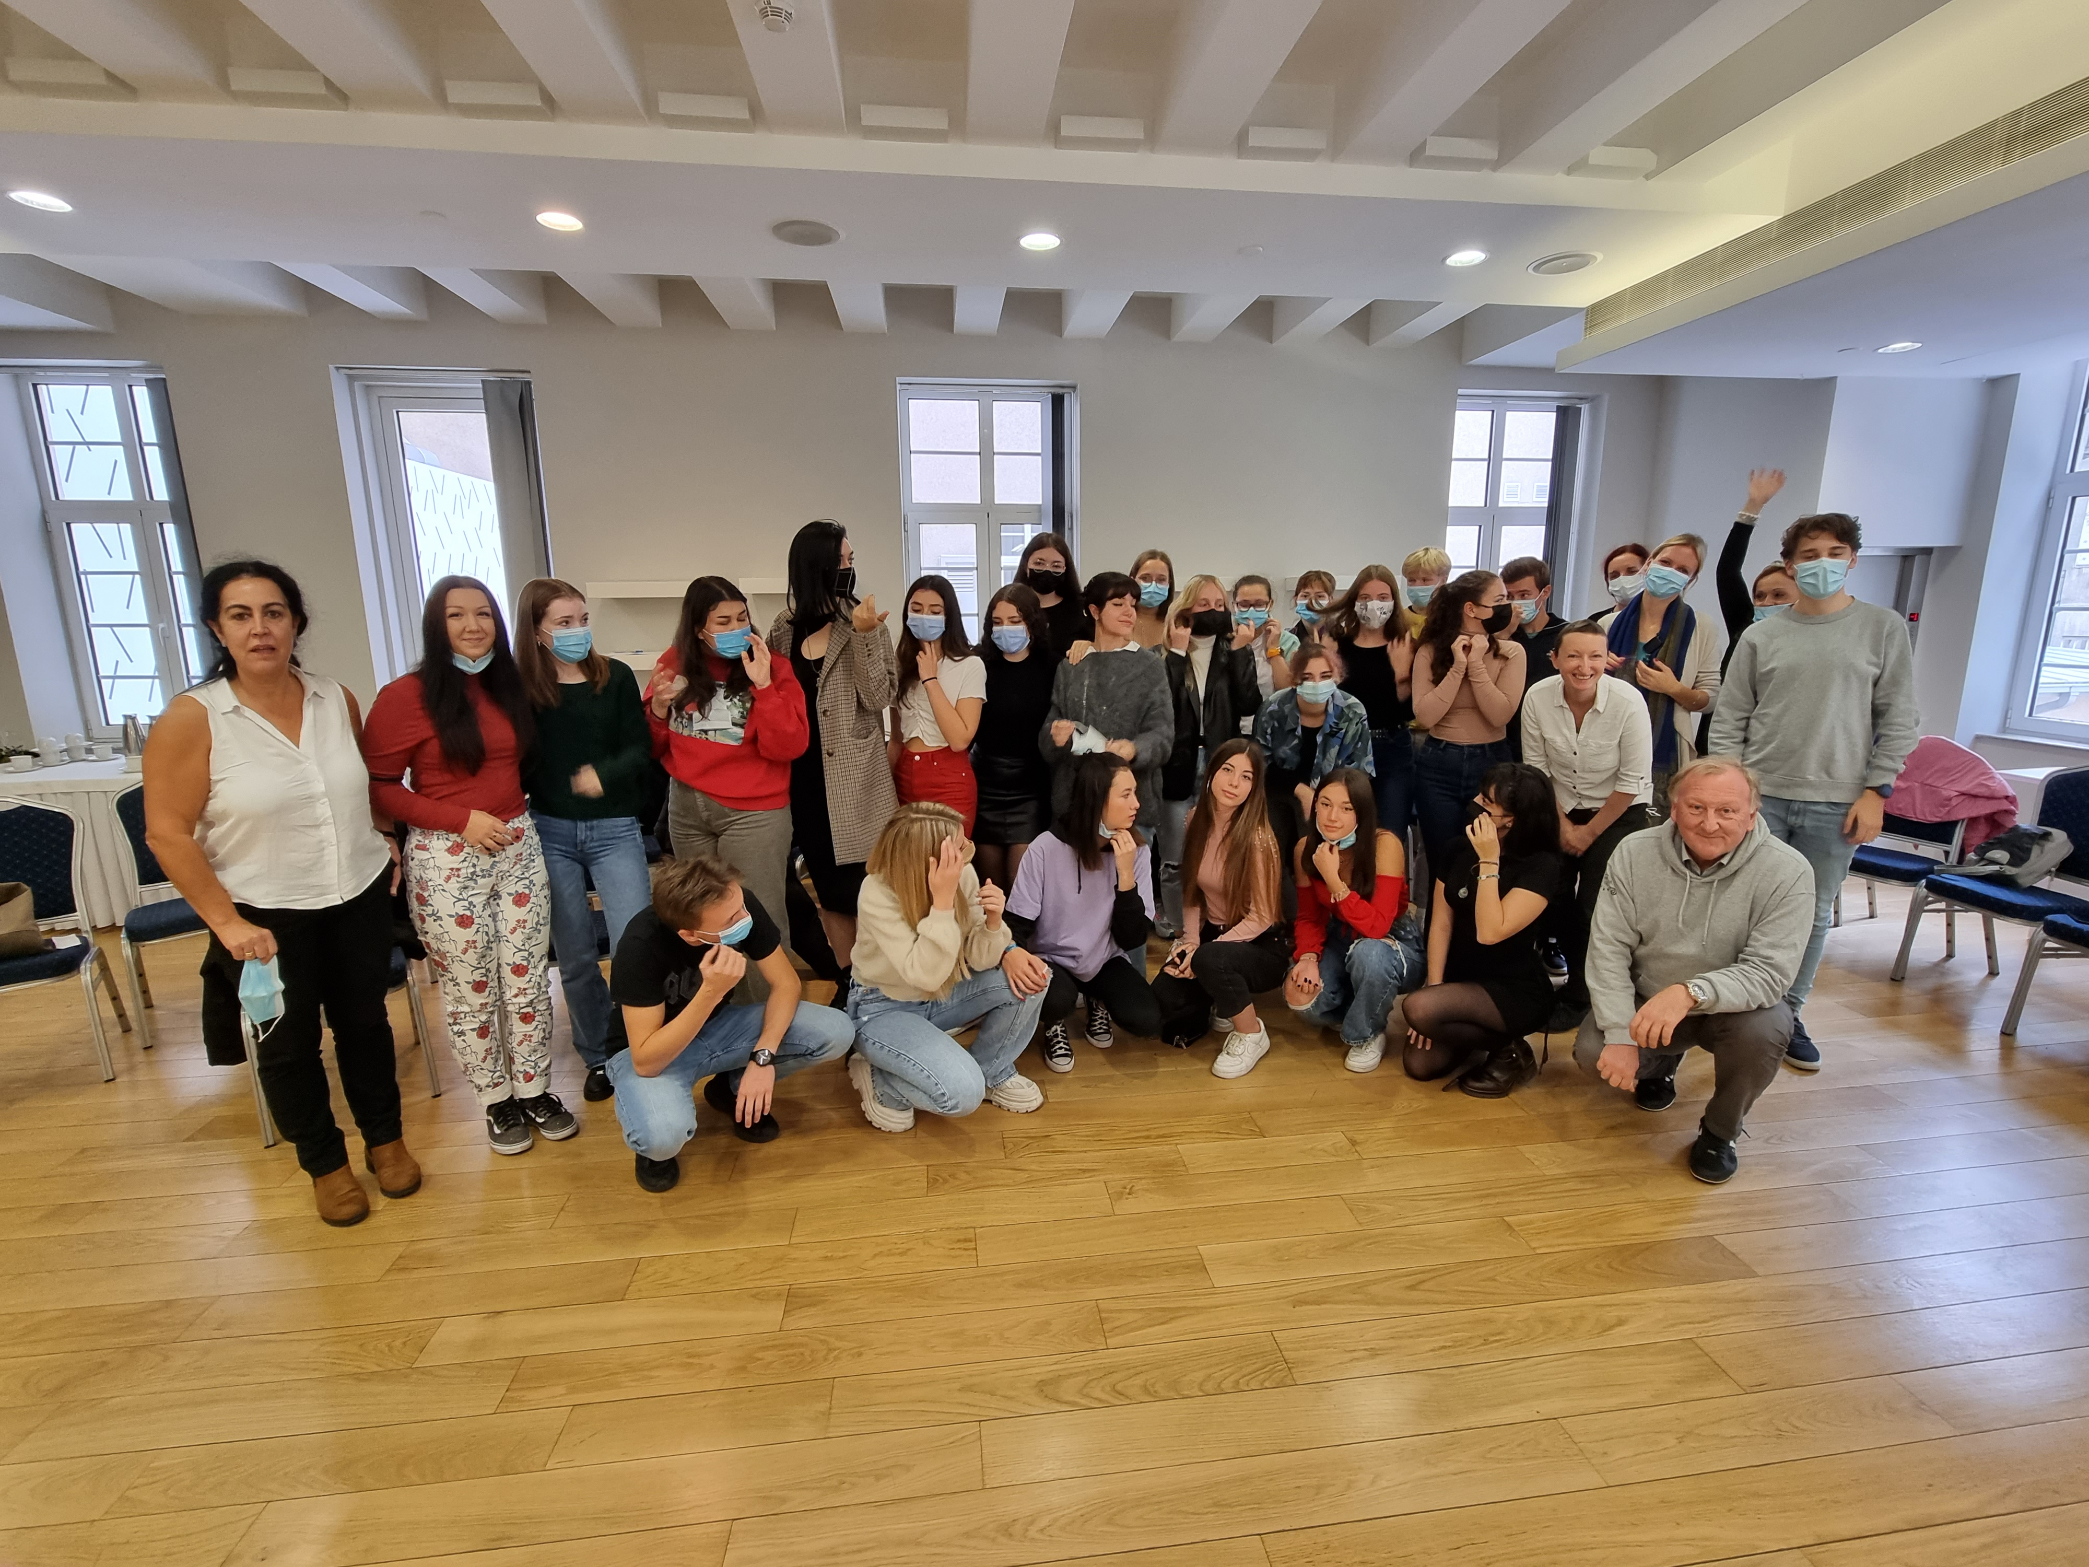
Short-term student exchange in belgrade, 11. – 15. 10. 2021
The short-term student mobility in Belgrade where we learnt about internet safety, information, cyber crimes and cyber bullying.

Slide 8
What HAVE we gained from this project?
We have explored different options to spend our leisure time. Current circumstances do not help to socialize as much as we want. Individual responsibility is essential.
We do not want to think about it since we believe we are free and independent but in fact we are easily manipulated by social media (we follow influencers or engage in absurd dangerous challenges). We tend to compare ourselves with others. Nobody is perfect and we have to learn to accept ourselves.
Cyberbullying is as harmful as any other kind of bullying as well as being a crime. We may think that words do not hurt but that's not true.

Slide 9
If you are interested in our topic, please contact us:
www.prvagim.si
http://iesordonosegundo.centros.educa.jcyl.es/sitio/
https://filoloska.edu.rs/novi/
We will be glad to provide you with more informaton.

